Slide 1
Movie Rating System
(Sentiment Analysis)
Akash Patel
(6824447)

Slide 2
Agenda
Goal
Technology Used
  Pipelines
  Jape rules
  Bayesian Classifier
User Interface (Client)
Evaluation
Demo

Slide 3
Goal
Movie rating system
According to user selected movie, system will fetch all data regarding to that movie and generate corpus dynamically.
After that, system will perform the sentiment analysis on it to find how much positive or negative the movie is according to users.
The tweets of followers and you followed given high priority.

Slide 4
Technology Used
Pipelines
  Basically I have created two pipeline. First Pipeline is using for generate corpus dynamically according to given movie name.
Second Pipeline is used for processing which implement
Classifier algorithm and normalization

Slide 5
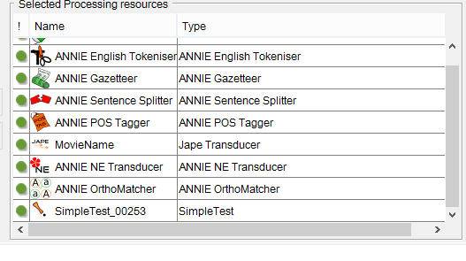
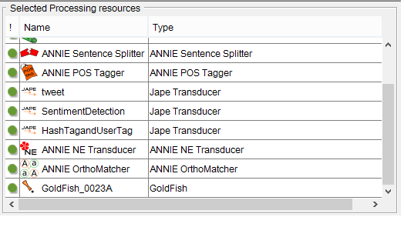
Pipelines

Slide 6
Technology used
I used three main JAPE rules
  Tweet – this jape rule is used to detect the tweets
  HashTagandUserTag – this jape rule has been used to detect the user tags or hash tags in the twitter data.
  SentimentDetect – this jape rule used for finding the particular tweet contain any sentiment or not?

Slide 7
Gazetteers
Two Gazetteer list
1) Positive Words
2) Negative Words

Slide 8
Classification Algorithm
(Multinomial Bayesian Classifier)
Why Multinomial Bayesian classifier ??

Slide 9
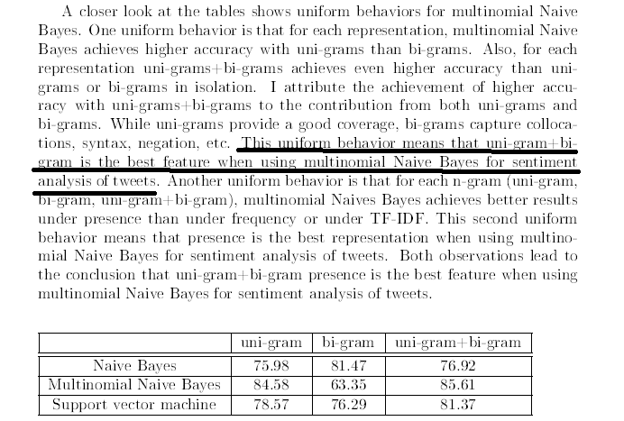
Bayesian classifier
Thesis of Gebrekirstos Gebremeskel from University of Malta

Slide 10
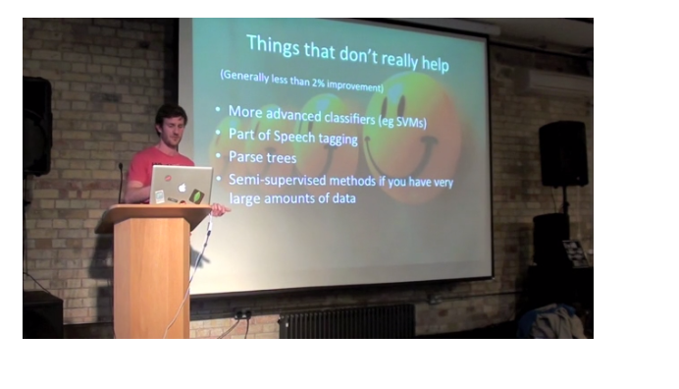
Bayesian Classifier
Alex Davies from the University of Cambridge

Slide 11
Bayesian Classifier
I create five different classes to rate the tweet
Class1
Class2
Class3
Class4
Class5
This is very good movie. You have to watch it!

Slide 12
Bayesian Classifier
Bayesian classifier will classify the tweet according to where it has higher probability to be classified.
For generation of training data, I gave rating to each keyword in positive as well as negative list. For example, Awesome – 5 , Good-4, Worst – 1. According to using those keyword, training dataset

Slide 13
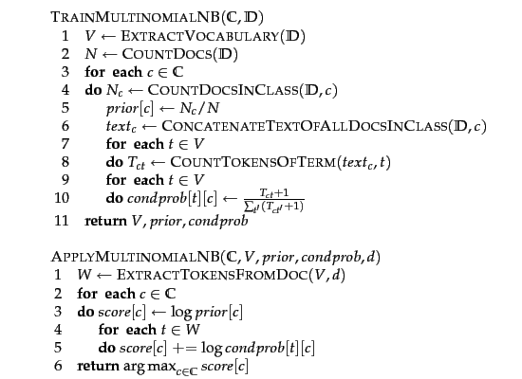
Multinomial Bayesian classifier
Algorithm

Slide 14
Normalization of Tweets
  Tweets contains Hugh amount of noisy data. I have to normalize it. E.g. removing URLS, remove other punctuations etc.
For generating the corpus, I am using Twitter4j library which is java wrapper to deal with the twitter data

Slide 15
User Interface
I used two different client to test my system
First, OpenOffice.
Second, Media Wiki. I create a page of movies then give to server for calculating the rating for each tweets.

Slide 16
Evaluation
For testing the sentiment algorithm. I have made java program with GUI to directly test the sentiment.

Slide 17
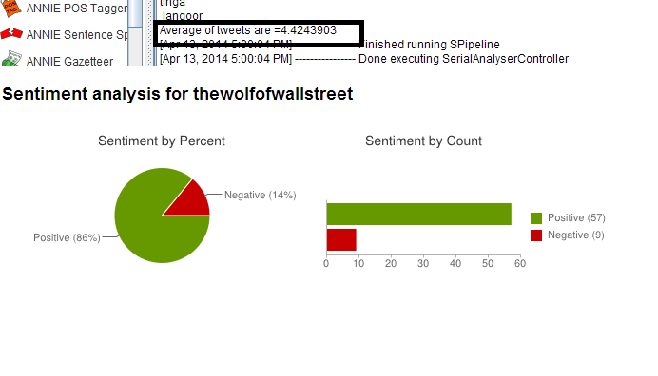
Comparison of Result with
Sentiment140

Slide 18
Manually annotate
I manually annotate 150 tweets from the movie The wolf of wall streets.
40 tweets out of 150 tweets actually was talking about movie
System actually rated 44 tweets which is quite near to 40.
The system given rating to 5 tweets was completely wrong.
4 tweets were missed by the system
Other 35 tweets are almost correctly rated. Some tweets has to be give 4 rating but system give 3 rating etc.
More accuracy can be come from the contextual information about movie

Slide 19
Demo!

